Slide 1

A BIOMETRICS MECHANISM OVER WIRELESS NETWORKS USING STEGANOGRAPHICMETHOD
D.Siva sai srikar(15MCE1036)
Guided by
BRINTHATHERESE.A

Slide 2

Research Objective
TO PROPOSE:
This project is to data hiding of a biometric signal in a video frame for secure transmission over wireless networks
It includes
1.semmetic segmentation
2. chaotic encryption
3.data hiding

Slide 3

Base Paper
Authors:
klimis ntalianisi(Member,IEEE)and Nicolas Tsapatsoulis2(Member,IEEE) “Remote Authentication via Biometrics:A Robust Video-ObjectSteganographicMechanism Over Wireless Networks” in IEEE TRANSACTIONS ON IMAGE PROCESSING, VOL. 25, NO. 9, Feburary 2016
In this paper a single image is taken and steganographed
It uses password authentication technique

Slide 4
Literature Survey –1
TITLE OF PAPER & Authors | JOURNAL / CONFERENCE & YEAR | Concept / Approach
Cryptanalysis and improvement of a biometrics-based multi-server authentication with key agreement . Hakhyun Kim, Woongryul Jeon, Yunho Lee and Dongho Won*, Senior Member, IEEE, | IEEE JOURNAL OF SELECTED TOPICS IN Cryptography VOL. 8, NO. 3, JUNE 2010 | A robust biometrics based multi-server authentication with key agreement scheme for smart cards on elliptic curve cryptosystem This scheme is vulnerable to off-line password guessing attack

Slide 5
Literature Survey –2
TITLE OF PAPER & Authors | JOURNAL / CONFERENCE & YEAR | Concept / Approach
An anonymous multi-server authenticated key agreement scheme based on trust computing using smart cards and biometrics Ming-Chin Chuang , Meng Chang Chen | THE JOURNAL OF INFORMATION TECHNOLOGY ACADEMIA,VOL.22, NO. 9, JUNE 2014 | Password-based remote user authentication schemes are widely investigated It has a combining a user’s biometrics with a password to design a remote user authentication scheme that enhances the level of the security

Slide 6
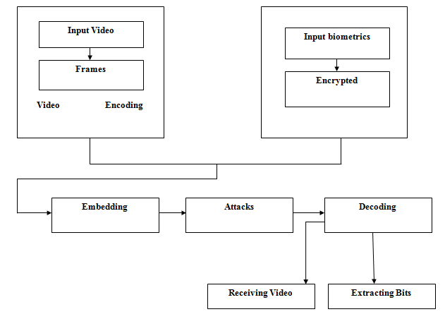
WORK FLOW of the project

Slide 7
WORK FLOW
MODULE 1
VIDEO TO FRAMES CONVERSION:
The video means multiple frames. The captured video is converted into frames using matlab codes as it act as a video to frame converter.

Slide 8
MODULE 2
THE ENCRYPTION MECHANISM:-
A biometric finger print is taken and encrypted using triple chaotic encryption
This encrypted signal is high secured

Slide 9
MODULE 3
HIDING THE ENCRYPTED BIOMETRIC SIGNAL:
The encrypted biometric signal is robustly hidden in the host video object. Towards this direction we aim at producing a stego-video object that could protects its hidden image even in case of compression
QSWTs can play such a role, since they provide one of the most robust solutions to data recovery

Slide 10
MODULE 3
Mutual authentication:-
This process is required to identify the server needs to verify that the user is a legal one, and the user needs to ensure that the server is not a forged one
if attacker intercepts the embeded message,cannot compute a valid message because of Hiding Capacity of the secret data bits is high.

Slide 11
MODULE 4
MESSAGE RECOVERY:-
After transmission over wireless channel the message can be recovered at receiver using same encryption algorithm
Message recovery will gives back original biometric signal and video of frame at receiver side

Slide 12
Hardware/ Software Requirements
MATLAB 7.14

Slide 13
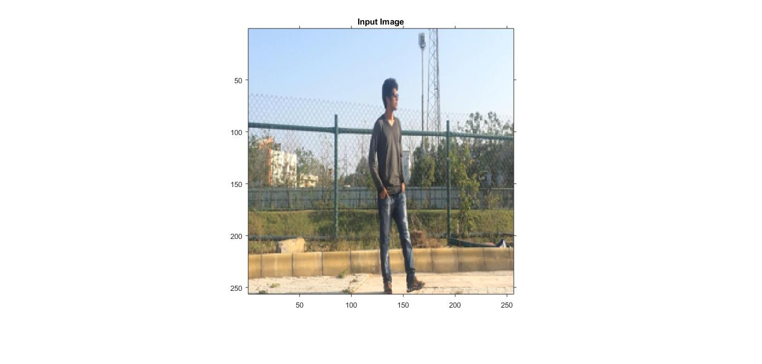
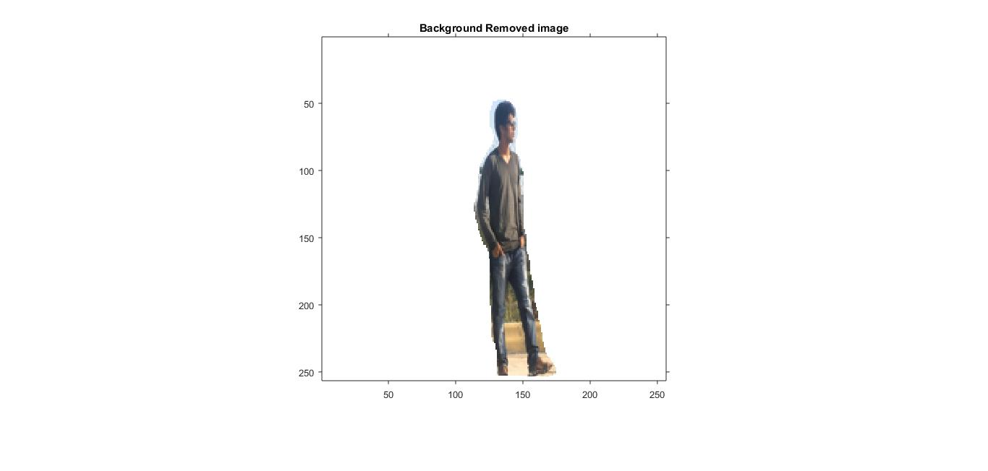
RESULTS AND DISCUSSION
A frame capured from video
The back ground removed for video frame

Slide 14
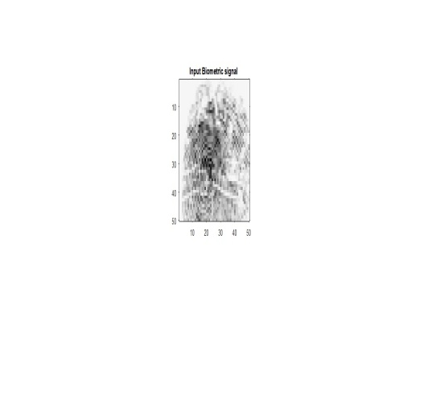
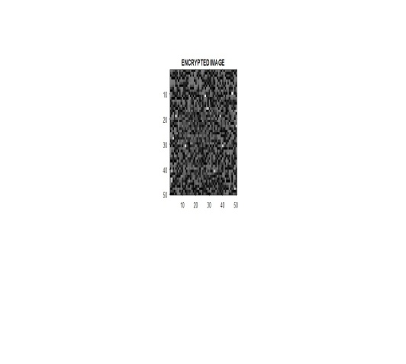
RESULTS AND DISCUSSION
Input biometric signal of mine
Encrypted biometric signal

Slide 15
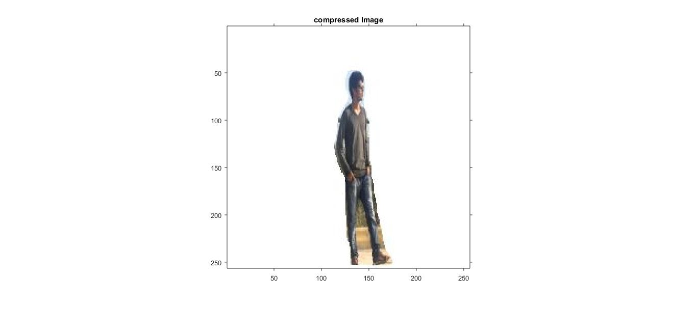
RESULTS AND DISCUSSION
the back ground removed image frame compressed image frame for transmission

Slide 16
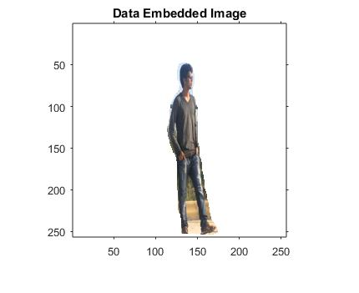
RESULTS AND DISCUSSION
Data embeded image

Slide 17
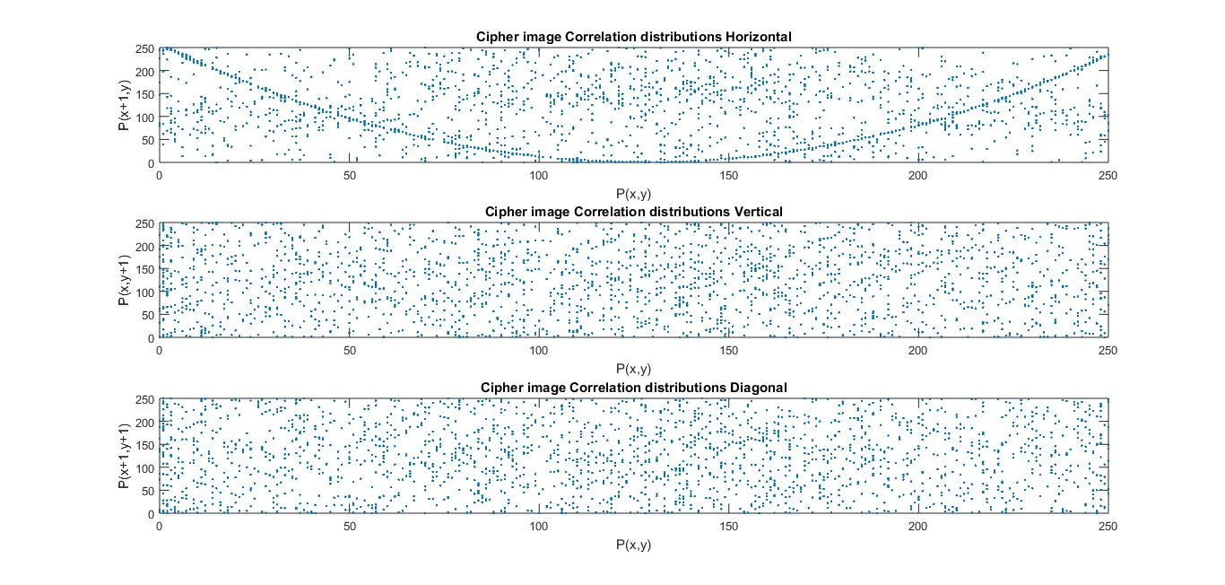
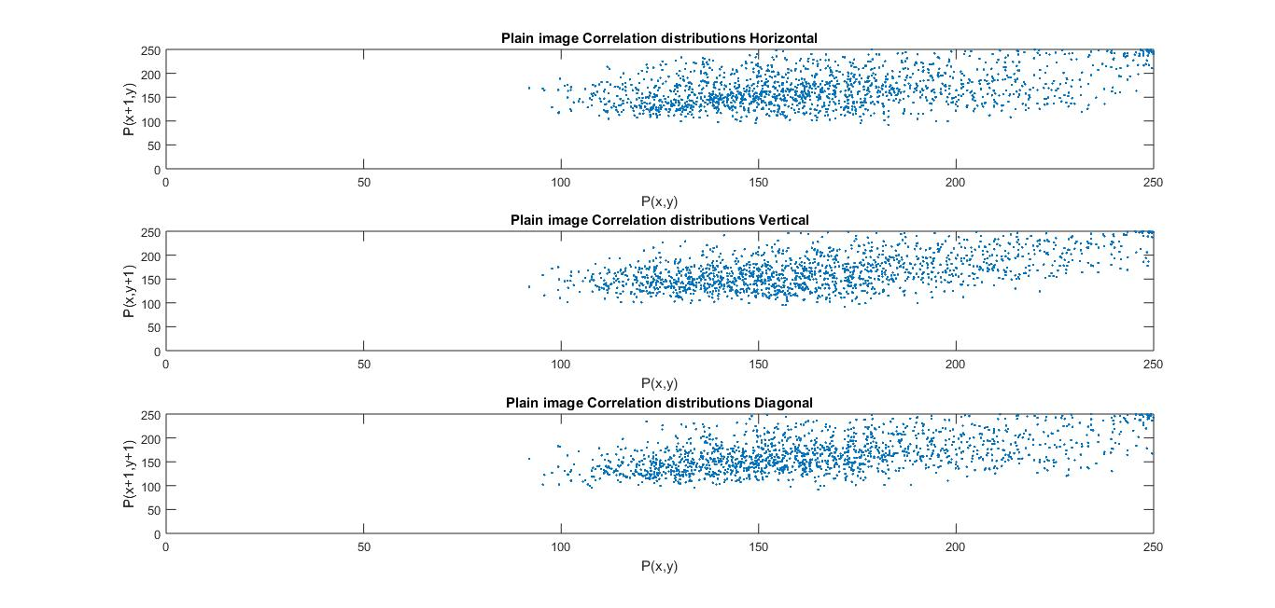
RESULTS AND DISCUSSION
Correlation after transmission
Correlation before transmission

Slide 18
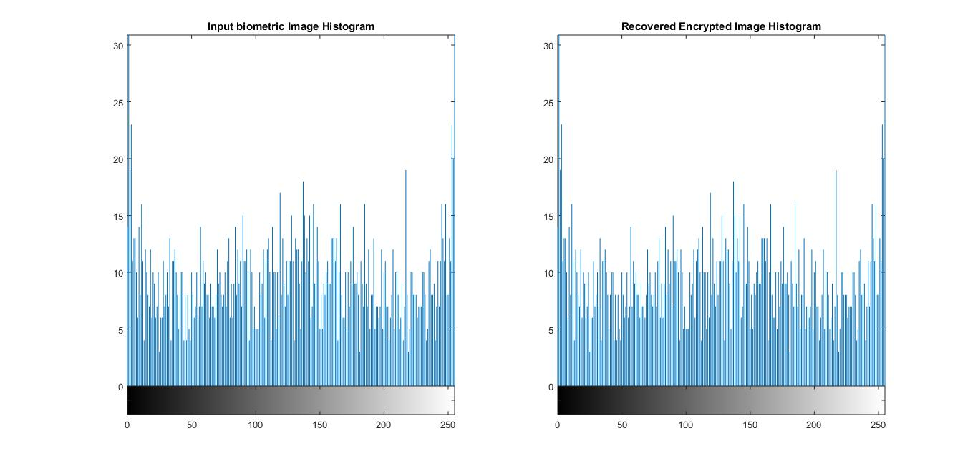
RESULTS AND DISCUSSION
Histogram of original and encrypted image frame

Slide 19
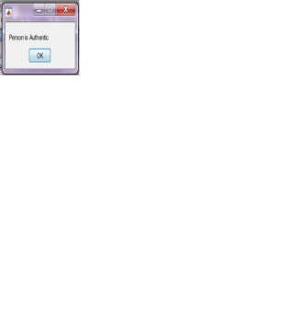
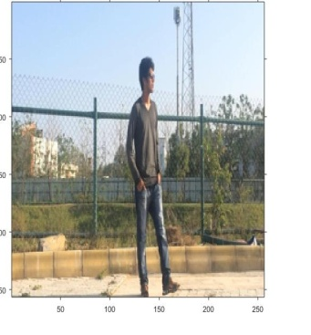
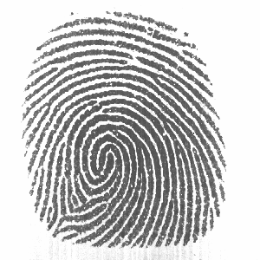
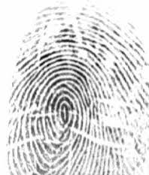
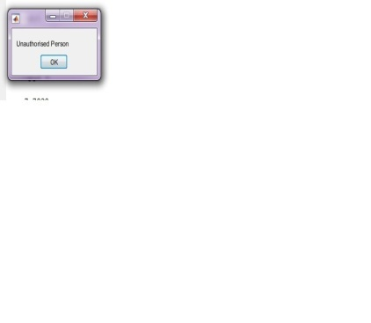
RESULTS AND DISCUSSION
Recovered image
Biometric signal of original person
Authorized biometric
Biometric signal of intruder
Un authorized biometric

Slide 20
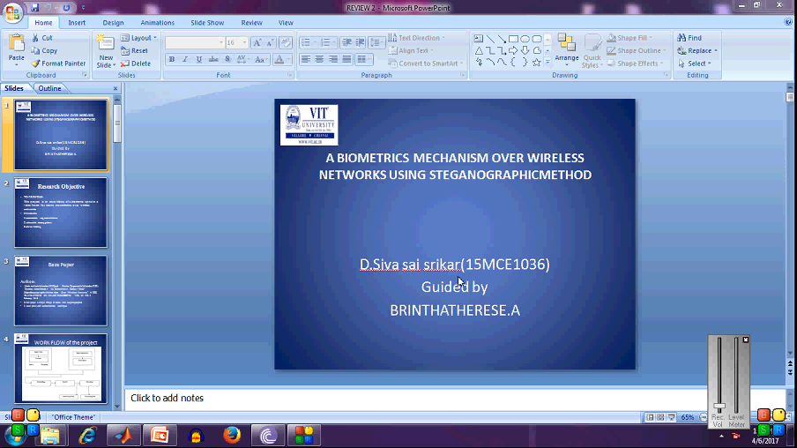
DEMO

Slide 21
APPLICATIONS
This technique reportedly has been used to detect the source of illegally copied movies.
Content identification and management
Content protection for audio and video content
Forensics and piracy deterrence
Content filtering (includes blocking and triggering of actions)
Communication of ownership and copyrights.

Slide 22
Challenges during implementation
Remote authentication involves the submission of encrypted information, along with visual and audio cues . So Trojan Horse and other attacks can cause serious problems, especially in cases of remote examinations (in remote studying) .
Implementation of steganography lacks shared secret key,a key dependent scheme is used.

Slide 23
STANDARDS AND CONSTRAINSTS
STANDARDS
IEEE 802.1X- Remote Authentication Dial In User Service
IEEE802.11-To provide wireless connectivity
IEEE208-1960-Video techniques feasible
IEEE802.15.6-stegnography techniques feasible
IEEESA-2410-2015-Biometric open protocol

Slide 24
constrainsts
The problem of lost biometric data is high of interest
This seeks large video objects so finally hash value in biometric signal should be utilized

Slide 25
Project Timeline / Work Plan
Literature study
Review 0
Literature study,Algorithm formulation
Review 1
Simulation results ,report
Review 2
final results, paper publication
Review 3
Milestone 2 Here
Milestone 4
Milestone 1 Here
9/10/2016
Milestone 3 Here
FINAL REVIEW
23/3/2017
26/8/16
6-1-2017
7/4/2017
Week 1-2
Week 3-4
Week 5-6
Week 11-12
Week 13-14
Week 17-18
APRIL
MARCH 2017

Slide 26
References
[1] A. Madero, Password secured systems and negative authentication. Thesis: S.M. in Engineering and Management, Massachusetts Institute of Technology, Engineering Systems Division, 2013. [Online]. Available: http://hdl.handle.net/1721.1/90691
[2] 2013, “Identity fraud report: Data breaches becoming a treasure trove for fraudsters,” Javelin Strategy and Research, Tech. Rep., 2013.
[3] E.-J. Yoon and K.-Y. Yoo, “Robust biometrics-based multi-server authentication with key agreement scheme for smart cards on elliptic curve cryptosystem,” The Journal of Supercomputing, vol. 63, no. 1, pp. 235– 255, Jan. 2013.
[4] H. Kim, W. Jeon, K. Lee, Y. Lee, and D. Won, “Cryptanalysis and improvement of a biometrics-based multi-server authentication with key agreement scheme,” in Computational Science and Its Applications, ser. Lecture Notes in Computer Science, vol. 7335. Spinger-Verlag, 2012, pp. 391–406.

